Slide 1
WELCOME TO THE SEMINAR
TEAM NAME : THE WINNING ALLIANCE
TAGLINE : TOGETHER,WE ELEVATE
TEAM MEMBERS :
KANISH RAJ.B(2112408022)
NAVYASHREE.C(2112408032)
NITHYA.L(2112408034)
THARUNASHREE.M(2112408047)

Slide 2
SEMICODUCTORS

Slide 3
INTRODUCTION
Semiconductors are materials with electrical conductivity between conductors (like metals) and insulators (like glass).

Slide 4
CHARACTERISTICS OF SEMICONDUCTOR
Variable Electrical Conductivity: Their conductivity can be adjusted through doping,
allowing for precise control in electronic applications.
Temperature Dependence: Unlike metals, their conductivity increases with temperature,
enabling temperature-sensitive electronic components.
Band Gap: They have a band gap between the valence and conduction bands,
which is crucial for their function in devices like diodes and transistors.
Light Sensitivity: Certain semiconductors can absorb photons.
P-N Junctions: The combination of p-type and n-type semiconductors forms p-n junctions,
essential for the operation of diodes and transistors.
High Thermal Conductivity: Some semiconductors possess high thermal conductivity.

Slide 5

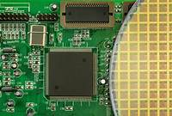
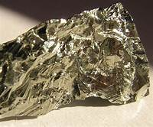
EXAMPLES OF SEMICONDUCTORS
Gallium Arsenide (GaAs)
Germanium (Ge)
Silicon (Si)
The most widely used semiconductor, essential in computer chips and solar cells.
Known for high electron mobility, used in microwave and infrared applications.
Used in early transistor technology and still important in high-speed electronics.

Slide 6
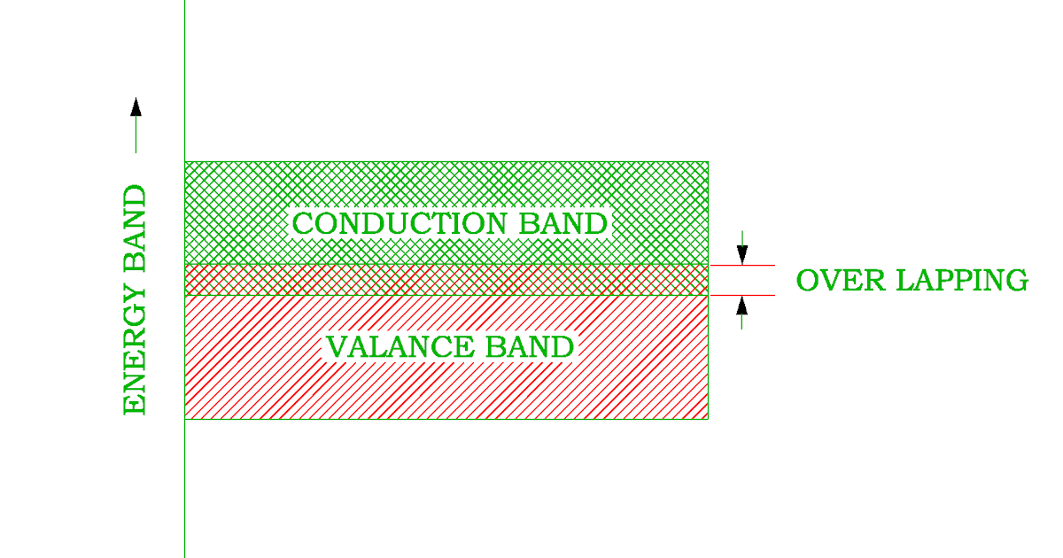
Conductors, insulators, and semiconductors
Conductors:
In a conductor, the valence band and conduction band are overlapped,
i.e. energy gap, Eg=0. Therefore electrons from valence band can easily
move into the conduction band. Therefore the conduction band is
completely filled by free electrons. As a result the resistance of
conductor is low and the conductivity is high. The resistance and
resistivity increases with increase in temperature.
Ex: All metals (Al, Cu, Fe, Au)

Slide 7
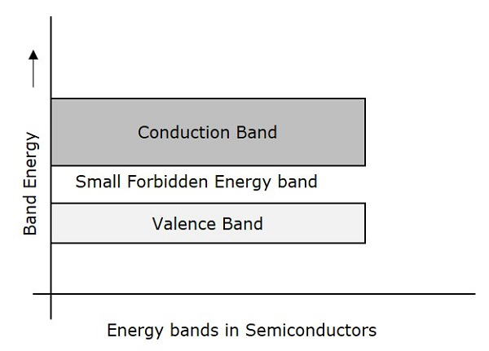
Semiconductors:
In semiconductor, the valence band conduction band are separated
by a small energy gap. i.e., Eg<3eV. Because of the small band gap
at room temperature some electrons from valence band can
acquire enough energy to cross the energy gap and enter the
conduction band. Therefore conduction band is partially filled with
free electrons at room temperature. As a result the semiconductor
conducts the current at room temperature. The resistance and
resistivity decreases with increase in temperature.
Ex: silicon, germanium, carbon.

Slide 8
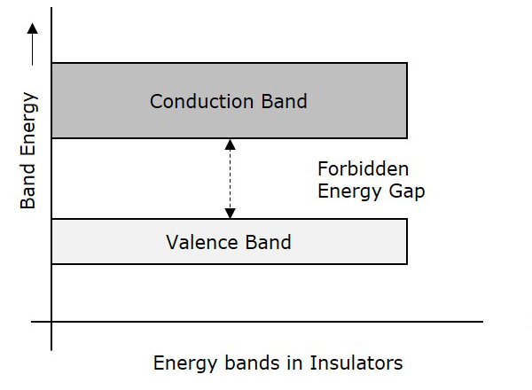
Insulators:
In insulators, the valence band and conduction band are
separated by a large energy gap, i.e. Eg>3eV.
Note that the energy gap is so large, the electrons
cannot be excited from the valence band to the
conduction band by thermal excitation. Therefore the
conduction band is completely empty, so no
electrical conduction is possible at room temperature.
Ex: plastic, wood, glass.

Slide 9
TYPES OF SEMICONDUCTOR
Intrinsic Semiconductors:
Pure semiconducting materials without impurities.
Example: Pure silicon.
Extrinsic Semiconductors:
Doped with impurities to enhance conductivity.
TYPES OF EXTRINSIC SEMICONDUCTORS:
n-type: Extra electrons (negative charge carriers).
p-type: Holes (positive charge carriers).

Slide 10
N-TYPE SEMICONDUCTOR | P-TYPE SEMICONDUCTOR
It is donar type. | It is acceptor type.
Pentavalent Impurity. | Trivalent Impurity.
Majority charge carries are free electrons. | Majority charge carries are hole.
Minority charge carries are holes. | Minority charge carries are free electrons.
It has 5 valence electrons. | It has 3 valence electrons.

Slide 11
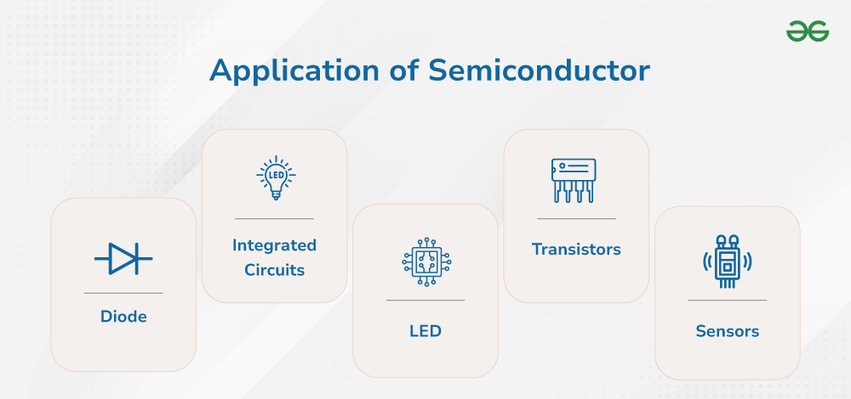

Slide 12
SUMMARY
Semiconductors are materials with electrical conductivity in between conductors and insulators.
They are of 2 types: Intrinsic (pure) and Extrinsic (doped with impurities)
Charge carriers: n-type(electrons) and p-type(holes)
They are widely used in smartphones, solar panels, radios, LED's etc.
Silicon is the most commonly used semiconductor because of its abundance, cost-effectiveness and properties.

Slide 13
THANK YOU

